Slide 1


Biomarkers in Treating Depression with Ayahuasca
Abhranil Das (Neo)
Dráulio Araújo lab

Slide 2
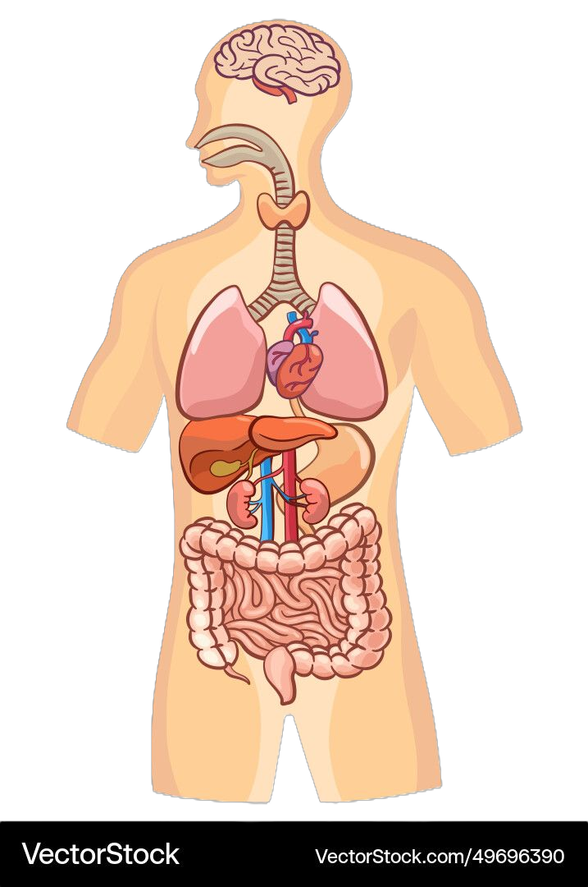
Questions
slide 2 of 11
Ayahuasca clinical trial for depression
brain:
BDNF
46 healthy, 29 with treatment-resistant depression
Each group split into ayahuasca and placebo
25 biomarkers collected before and after treatment
blood:
IL-6
RBC
WBC
platelets
neutrophil
monocyte
eosinophil
hematocrit
hemoglobin
lymphocyte
liver:
CRP
ALT
AST
LDL
HDL
glucose
triglycerides
How do biomarkers differ between healthy and depressed people?
How do biomarkers change after treatment in healthy and depressed people?
Which biomarker changes correlate with improvements in depression?
kidney/adrenal glands:
urea
cortisol
sodium
creatinine
potassium
Palhano-Fontes et al (2018). Rapid antidepressant effects of the psychedelic ayahuasca in treatment-resistant depression: a randomized placebo-controlled trial. Psychological Medicine

Slide 3
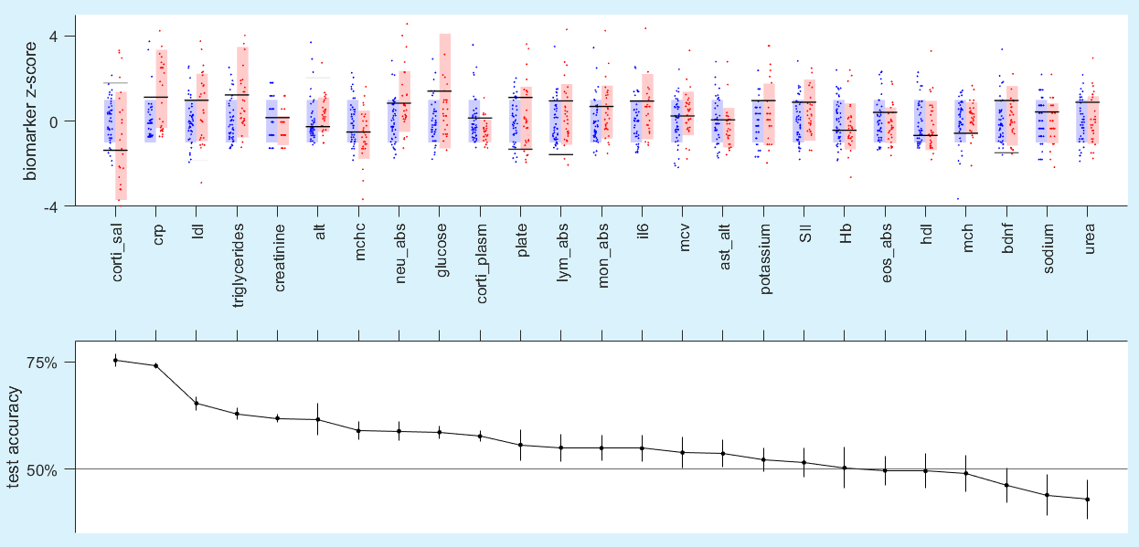
slide 3 of 11
1. How do biomarkers differ between healthy and depressed?
Depressed people have both lower and higher corti_sal. Low: fatigue / High: stress.
In depressed, CRP, triglycerides, glucose & IL-6 are higher.
Salivary cortisol and CRP are the best individual markers to separate healthy / depressed (75% accuracy each).
CRP indicates inflammation, increased fatigue & anhedonia.
QDA boundaries
healthy depressed
Notes:
Individual marker distributions. Rectangles are error bars.
The blue rectangles are all the same, because all markers have been z-scored wrt H0.
Agreement with marker lit.
Lines are classification boundaries using each individual marker. Explain QDA.
When two distributions vary in mean as well as sd, eg cortisol, the best classification boundary is a quadratic, not a linear. It has two boundaries, not one.
But one of those two boundaries may do most of the job (explain alpha).
The 5-fold CV test accuracy is plotted below, and the markers have been sorted by this.
In most cases, using the best single boundary is enough.
Corti_sal and crp are the best individual markers in distinguishing H from D.
The markers have been sorted by these, so the blue/red rectangles become more similar down the line.

Slide 4
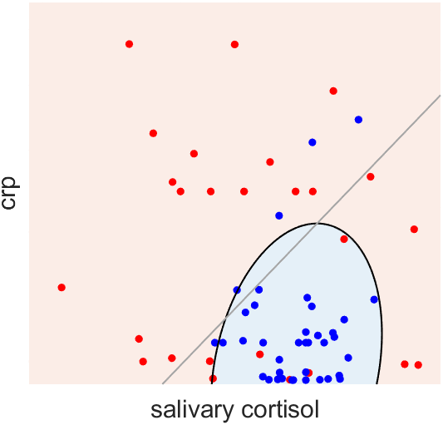
slide 4 of 11
Classifying with the top 2 markers
Quadratic boundary exploits the tighter range of cortisol in healthy.
When adding a marker, only new info counts.
Added CRP not because it was the second-best, but because it adds the most accuracy.
healthy depressed
quadratic boundary: 84%
linear boundary: 74%

Slide 5
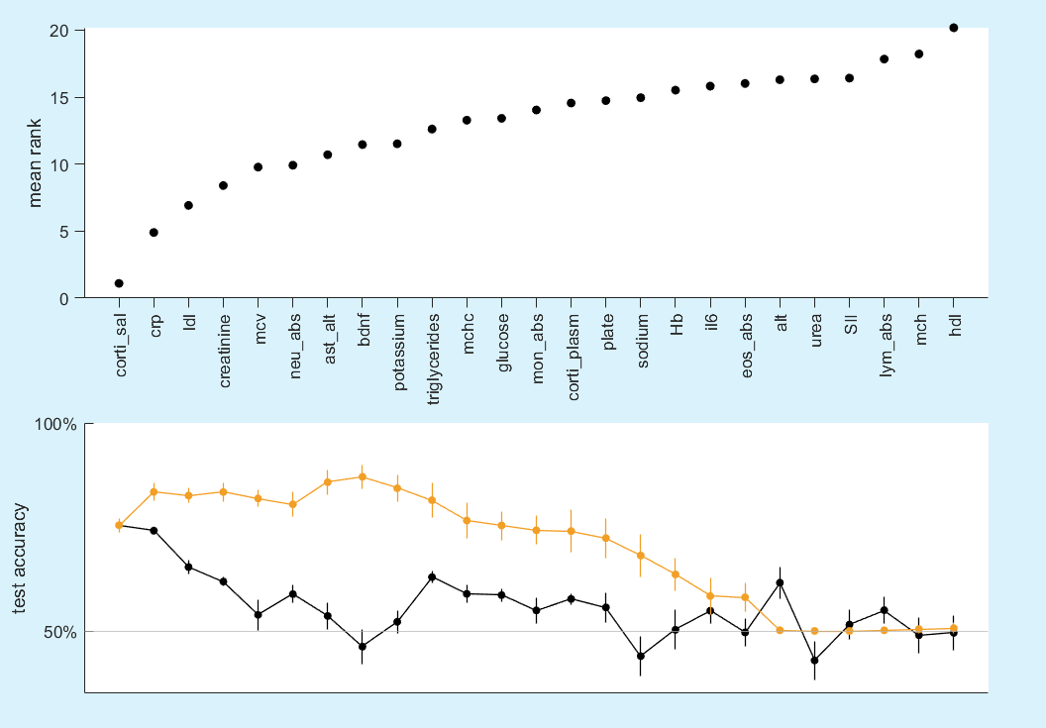
Building an optimal group of markers
slide 5 of 11
Used a greedy algorithm to add markers one by one.
Found the mean rankings across many runs
Combined accuracy first rises (underfitting), then falls (overfitting).
Salivary cortisol and CRP together are good enough
Beyond these 2, best markers are not in order of individual accuracy
combined accuracy
individual accuracy

Slide 6
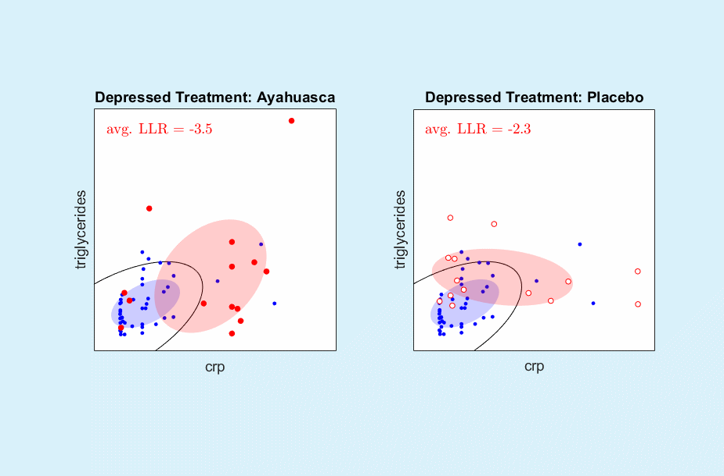
slide 6 of 11
2. How do the markers of the depressed change after treatment?

Slide 7
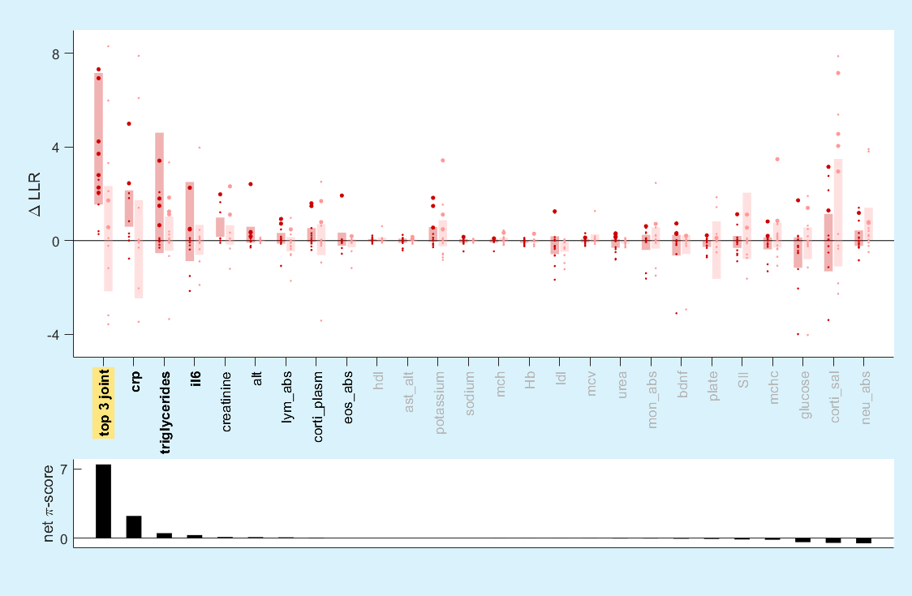
slide 7 of 11
2. How do the markers of the depressed change after treatment?
Markers are scored by:
  how much aya treatment shifts it towards baseline healthy
  how much extra, and how reliably, aya shifts it compared to placebo
markers that most separate H/D are not the ones most shifted towards healthy.
the top 3 markers combined shows much better improvement than their sum
ayahuasca placebo

Slide 8
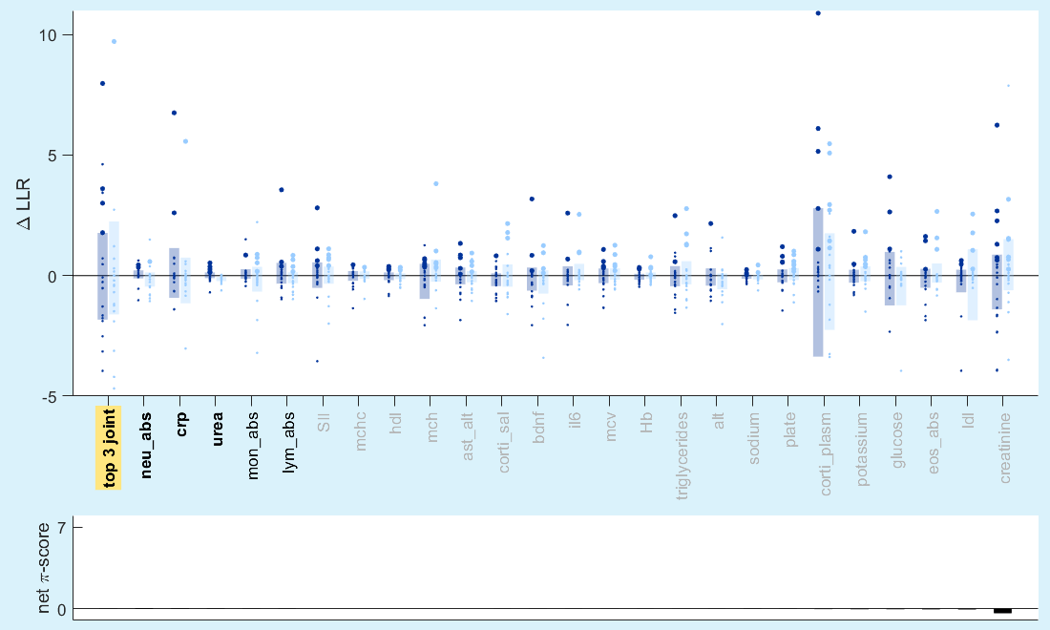
slide 8 of 11
3. How do the markers of the healthy change after treatment?
LLR can show if the markers in the healthy shift even closer to healthy values.
No marker showed such significant shift.
ayahuasca placebo

Slide 9
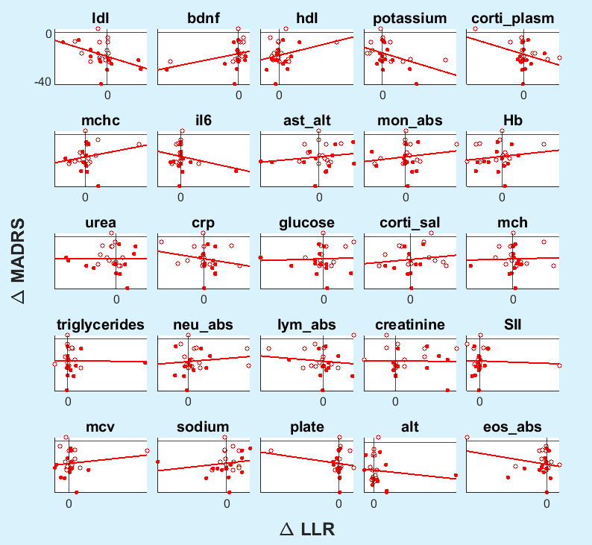
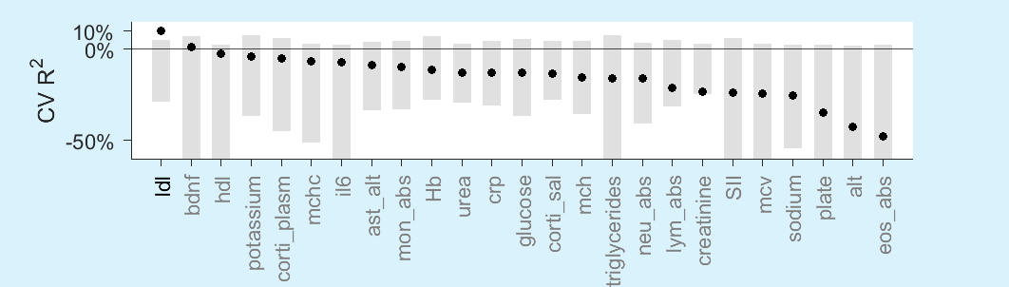
slide 9 of 11
4. Which marker changes correlate with feeling better?
Plot against ΔLLR of biomarker, instead of raw difference.
We keep placebo patients.
We want three criteria:
  negative slope
  cross-validated R² > 0
  p < 0.05
Only LDL cholesterol shows a moderate effect (10% variance explained).
A stressed body releases energy into blood to prep for action. If unused, it accumulates as LDL.

Slide 10
slide 10 of 11
Conclusions
Salivary cortisol and CRP together best separate healthy from depressed.
In the depressed, CRP & triglycerides recovered most towards healthy values after ayahuasca treatment.
In the healthy, no markers recovered more towards healthy values after treatment.
LDL recovery towards healthy values is moderately correlated with improvements in depression.

Slide 11







Thanks
Fernanda Palhano-fontes
Sergio Mota-Rolim
Rodrigo Santiago
Inácio Gomes Medeiros
Gabriel Soares

